Slide 1
What do you think of when you think of the UK Economy?
Wordcloud (as the students walk in)
Discuss in pairs/small groups 3 min

Slide 2
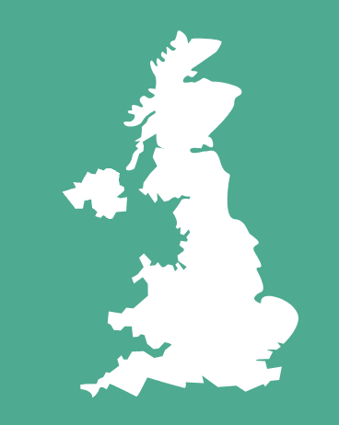
Know Your Own Economy (UK)

Slide 3
Learning outcomes
At the end of this session you should be:
Be able to explain aspects of the UK economy to a peer
Identify the main industries in the UK today and historically
Discuss the key challenges and strengths of the UK economy

Slide 4
Overview
Part 1: Historical Legacy
Quiz
Part 2: 70s & 80s and its legacies
Part 3: Current challenges and strengths
Activities

Slide 5
Overview
Part 1: Historical Legacy
From a sun never sets empire to offshore financial centres
UK trade and exports: then and now
Class and Inequality
Quiz
Part 2: 70s & 80s and its legacies
Union participation
Rail strikes and wage bargaining
Privatisation
Part 3: Current challenges and strengths
Challenges: Productivity and cost of living
Strengths: Pharma and Tech

Slide 6
What economies are we a part of?
Global
Local: Neighborhoods, Municipalities and counties
National: England, Wales, Scotland and Northern Ireland
Regional: UK?, Europe
Notes:
Think of the different types of economies that you are a part of. What is your local economy, what characteristics does it have? You have a neighborhood economy as well as a municipal/district/council/borough one.
This lecture is mostly only focused on the national part of the economy.

Slide 7
Part 1
Historical Legacy

Slide 8
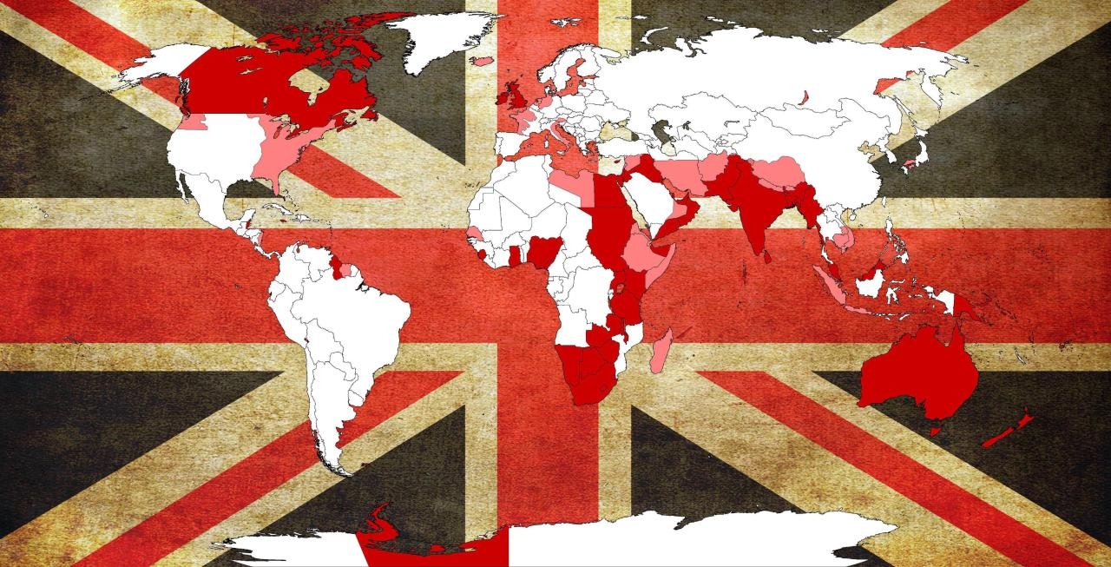
Notes:
The British Empire, often referred to as "The Empire on which the Sun Never Sets," was one of the most extensive and influential empires in world history. This vast imperial network spanned the globe, encompassing territories on every continent, and its reach was so extensive that it was said that the sun never set on the British Empire. The empire was at its peak during the 19th and early 20th century.

Slide 9
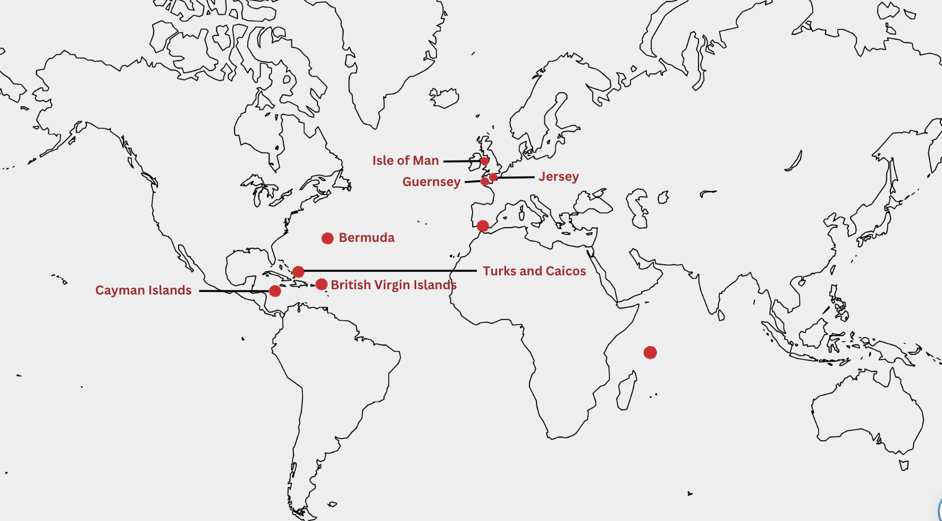
Map over offshore spots and links to the City
Notes:
The UK retains a smaller number of overseas territories today, including places like Gibraltar, Bermuda, and the Falkland Islands. These territories have a degree of self-governance and autonomy, distinct from the direct rule of the past. They have more economic relationships.

Slide 10
Offshore spots and links to the UK and the City
UK’s historical link to most tax havens
3 rings of links to the City
Outer ring: Hong Kong and the Bahamas
Intermediate ring: Britain’s 14 overseas territories
Inner ring: Crown dependencies (Jersey, Guernsey, and Isle of Man)
Ongoing debate: what is the role of UK?
An offshore financial centre (OFC) is defined as a "country or jurisdiction that provides financial services to nonresidents on a scale that is unproportional to the size and the financing of its domestic economy
Notes:
The UK has a historical link to many tax havens due to its colonial past. Territories such as the British Virgin Islands, Bermuda, and the Cayman Islands are British Overseas Territories or Crown Dependencies that have retained a degree of autonomy in managing their tax and financial systems. This relationship has enabled these jurisdictions to develop as offshore financial centers.
London, the UK's capital, is a global financial center that serves as a hub for financial services. Many international companies and wealthy individuals utilize the City of London for their financial transactions and investment activities, often involving offshore entities in tax havens.

Slide 11
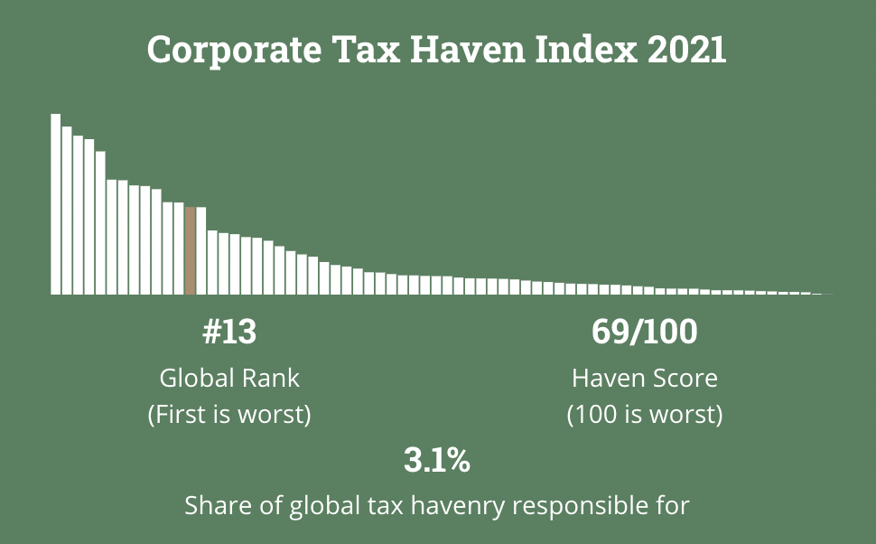
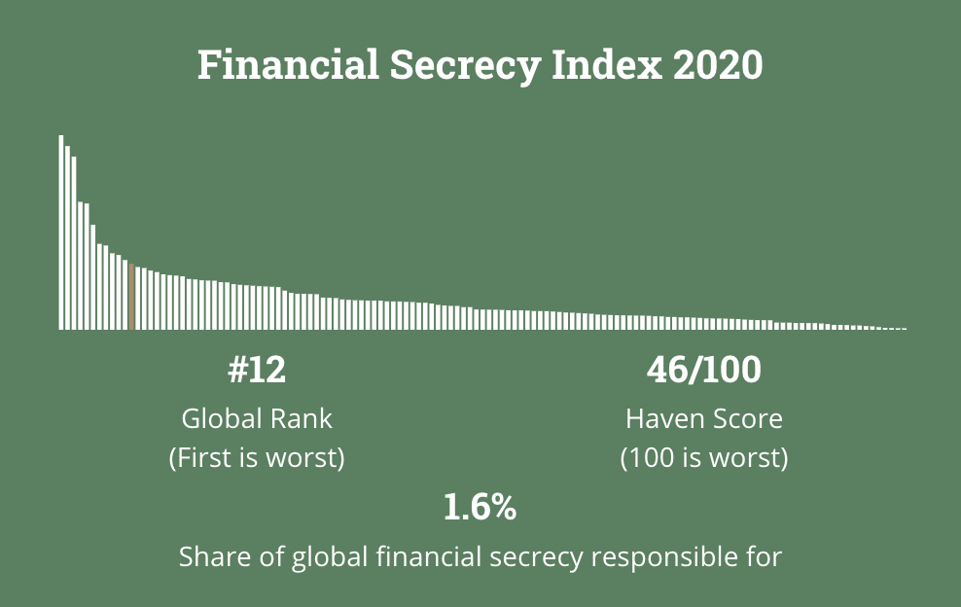
UK Tax Haven Ranking
Source: Tax Justice Network
Notes:
Although UK is not known as a tax haven itself, it does score high as a corporate tax haven as well on financial secrecy according to the Tax Justice Network’s index. But many of the top countries are linked to the former British Empire and current crown dependencies.
Source: https://taxjustice.net/country-profiles/united-kingdom/

Slide 12
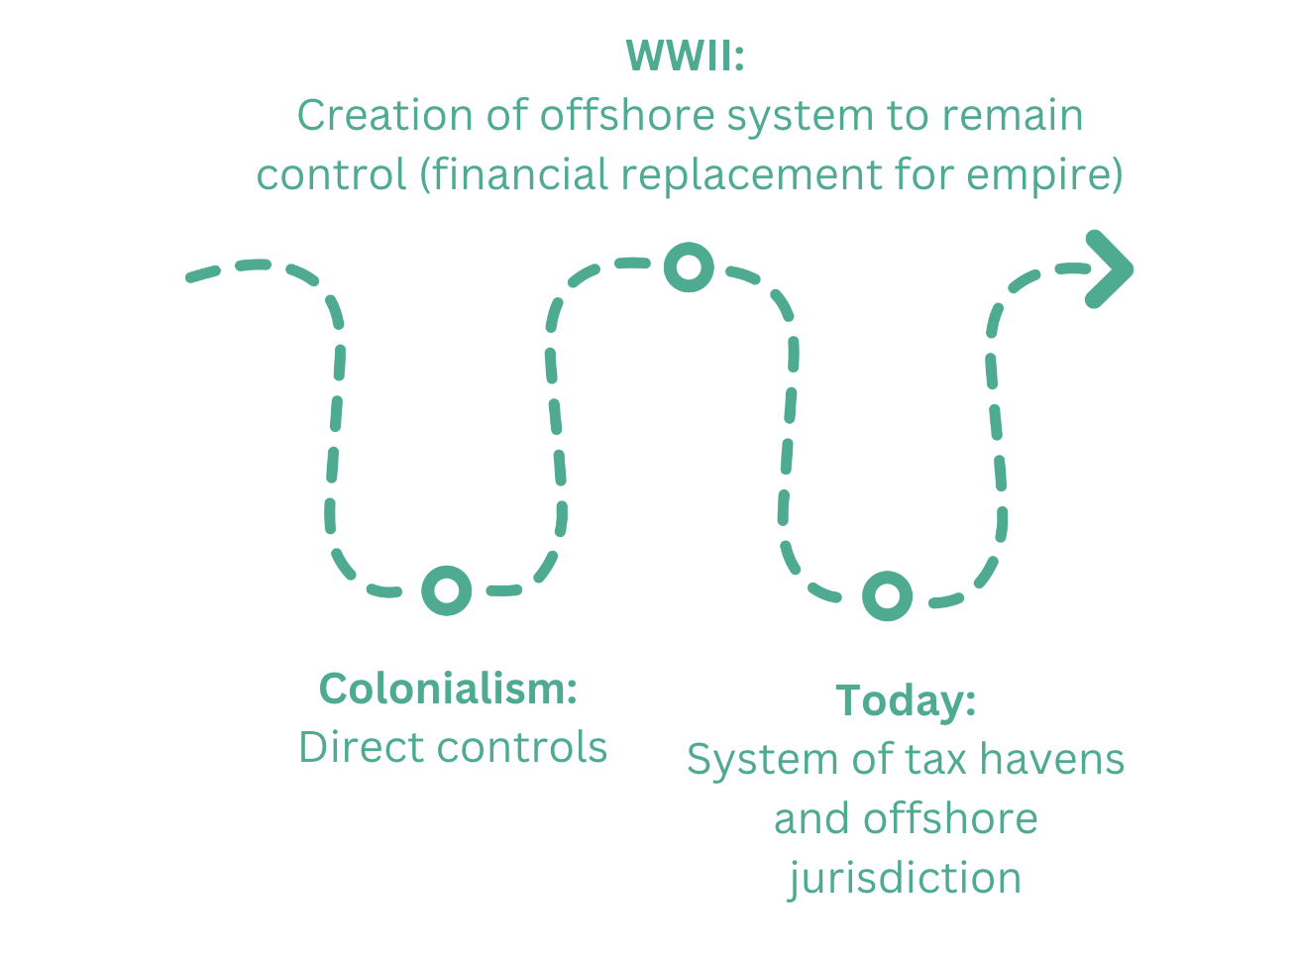

Slide 13
Main export industries over time (version 1)

Slide 14
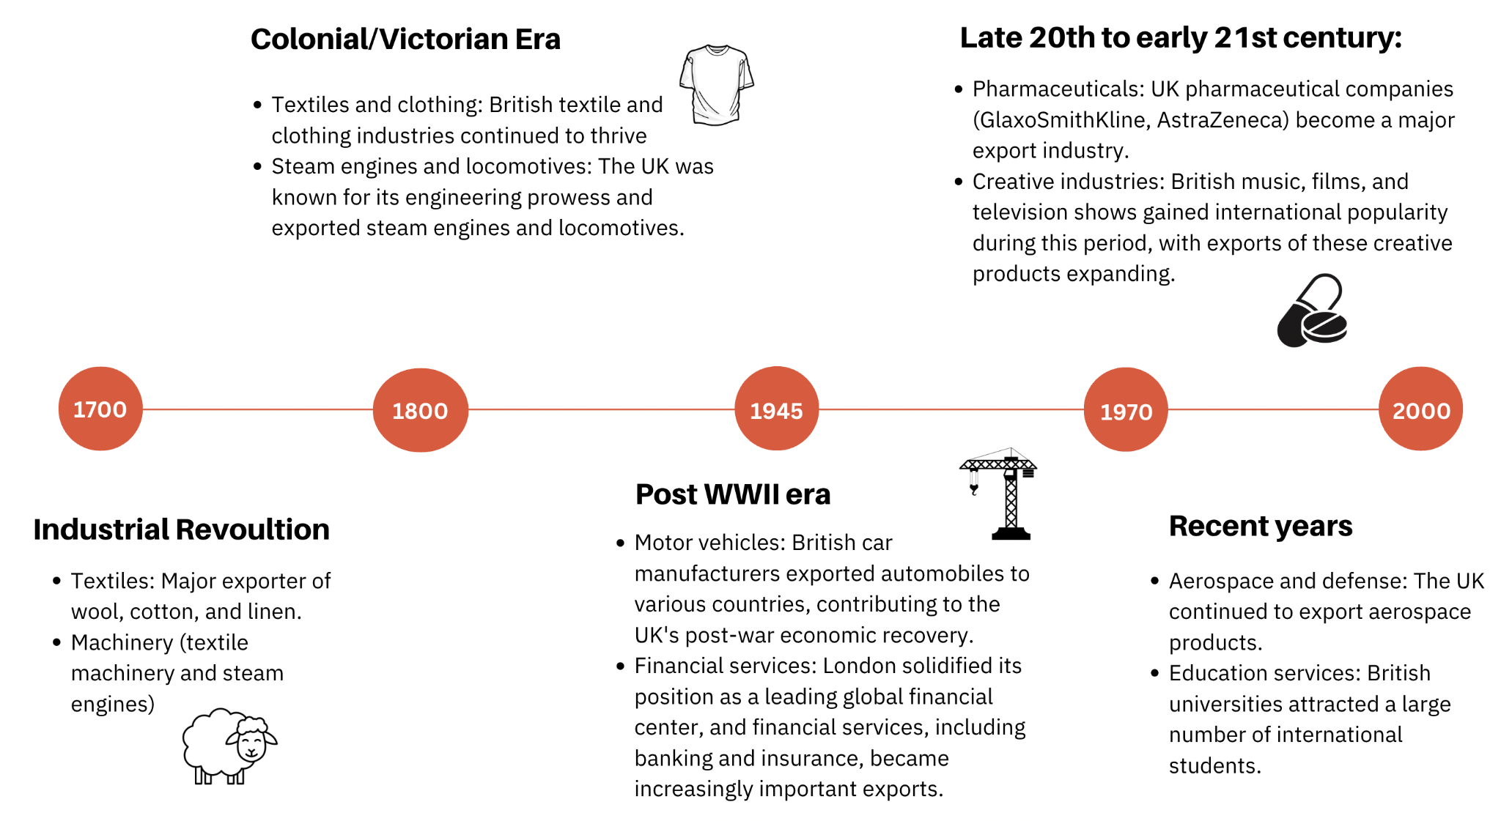
Main export industries over time (version 2)
Notes:
Extended version

Slide 15
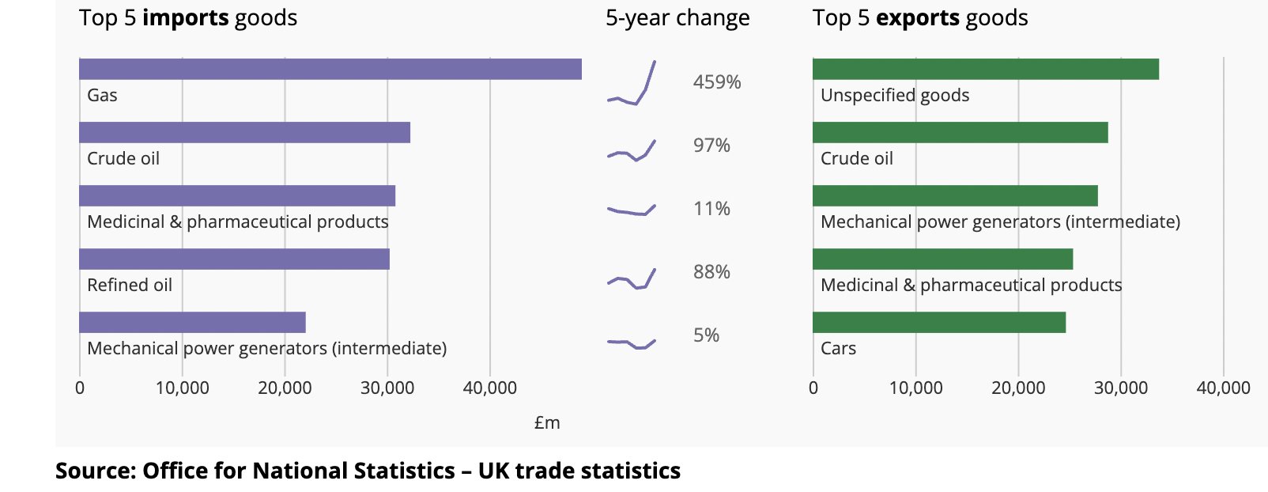
UK Trade in Goods 2022: Top 5 import/export
https://www.niesr.ac.uk/blog/uk-trade-and-exchange-rate
Notes:
UK Trade in goods 2022
Source: Office for National Statistics – UK trade statistics https://www.ons.gov.uk/economy/nationalaccounts/balanceofpayments/articles/uktradeingoodsyearinreview/2022#:~:text=The%20increases%20in%20imports%20in,EU%20and%20non%2DEU%20countries.

Slide 16
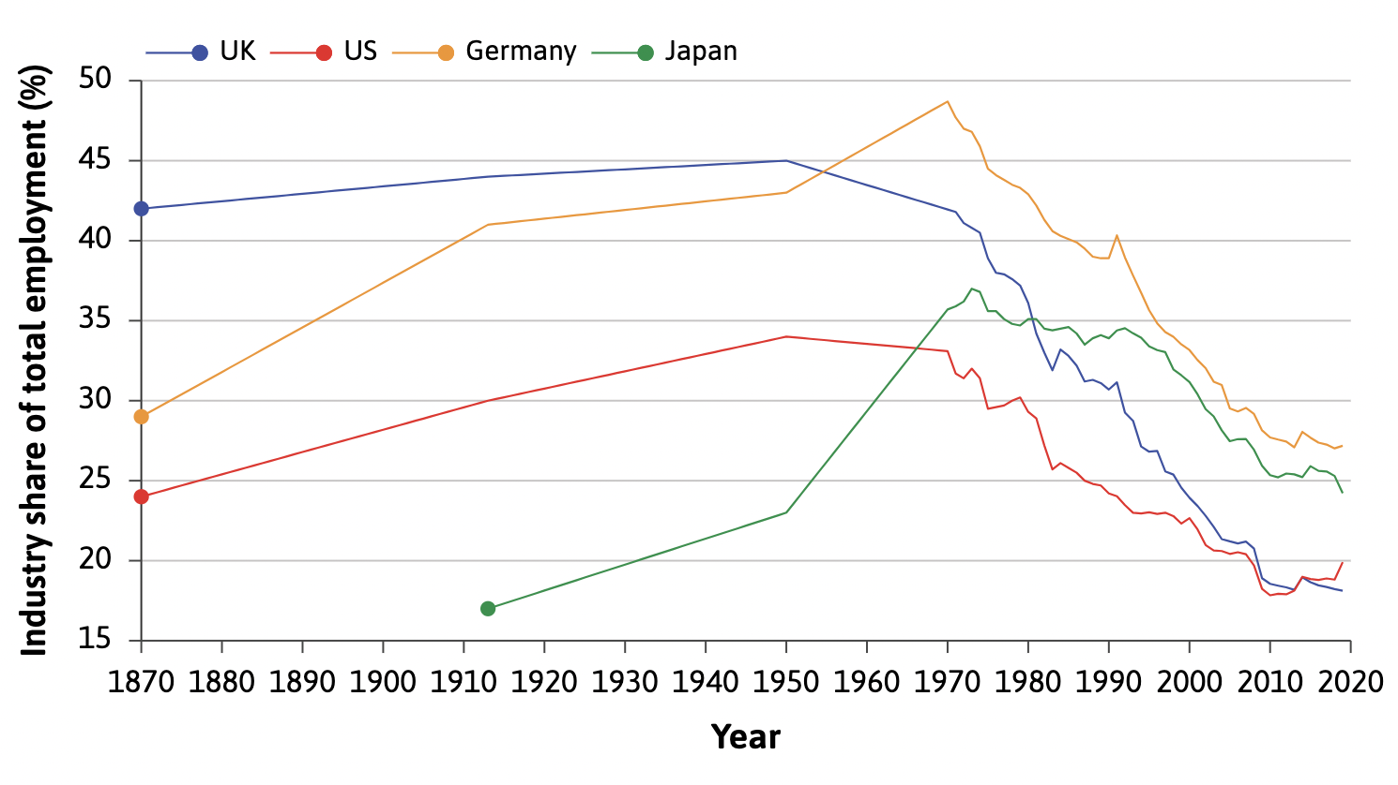
Industry employment share 1870-2020
Notes:
UK had one of the highest industry share of total employment up until the post-war era. Today it has one of the lowest, thus, UK had one of the largest declines in this type of employment.
Source:

Slide 17
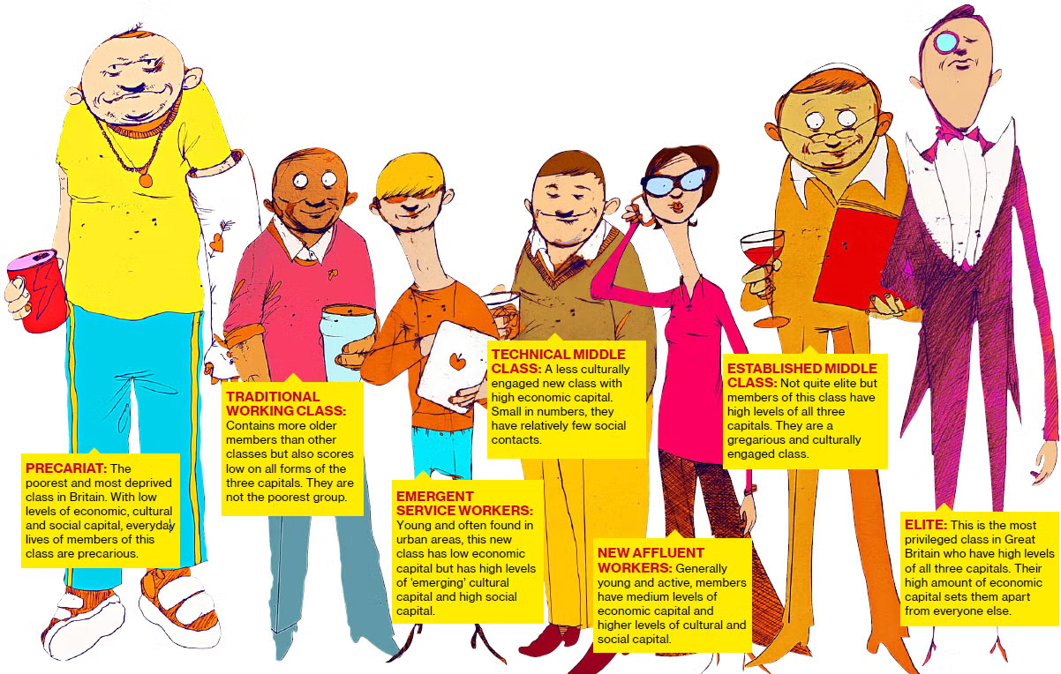
A historic UK class perspective
Notes:
The United Kingdom has a long history of class distinction and stratification, which has evolved over time. Traditionally, the UK's class system was primarily characterised by three broad classes, but in recent years, it has become more complex, with the emergence of a seven-class model. This transformation reflects changes in society, the economy, and the way we understand social status.
The evolution from a three-class to a seven-class system in the UK reflects the complexities of contemporary society, marked by economic, cultural, and social changes. Recognising these nuances in class distinctions is essential for understanding modern British society and addressing issues of inequality and social mobility.
Great British Class Calculator: https://www.bbc.co.uk/news/special/2013/newsspec_5093/index.stm

Slide 18
Which class do you belong to?
Elite: A small, privileged group with significant wealth and influence.
Established Middle Class: Professionals, managers, and high-level white-collar workers with secure, well-paying jobs.
Technical Middle Class: Individuals in technical and skilled professions, often with a strong educational background.
New Affluent Workers: Skilled workers in expanding sectors, such as IT and finance, who enjoy relatively high incomes.
Traditional Working Class: Manual and industrial workers with blue-collar jobs.
Emergent Service Workers: Individuals in low-paid service industry roles, often lacking job security.
Precariat: A vulnerable class with insecure, low-wage employment, including part-time and temporary workers.
Notes:
Class activity?
https://www.bbc.co.uk/news/special/2013/newsspec_5093/index.stm

Slide 19
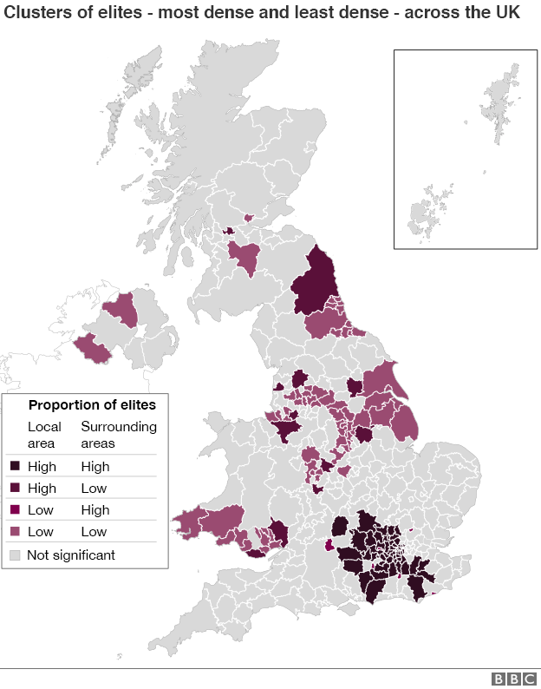
Where the elites are most concentrated across the UK
Notes:
Source: BBC

Slide 20
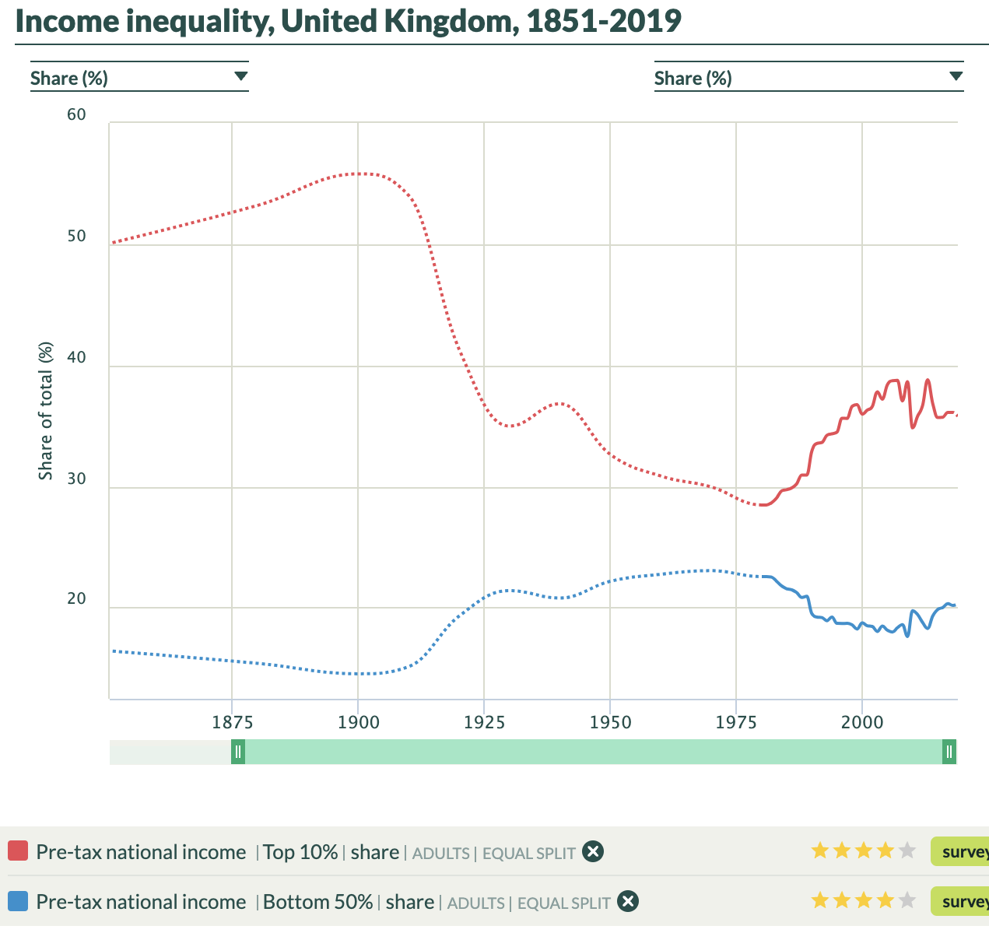
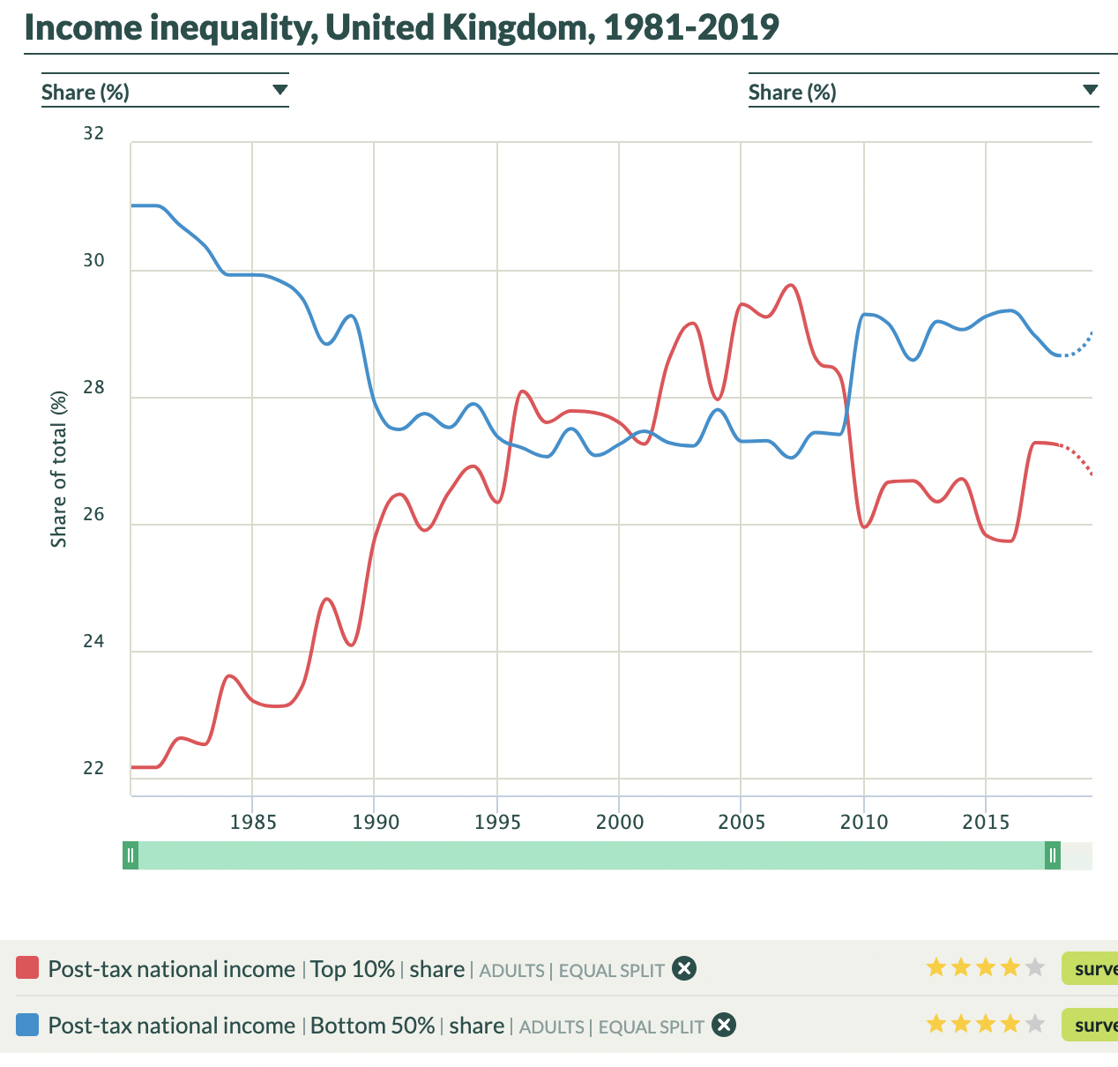
Notes:
https://wid.world/country/united-kingdom/
The bottom 50% have had roughly around 20% of the total share of national income over the last decades or century, staying relatively stable. The top 10% however has gone through significant changes, being above 50% (pre-tax) a century ago, but dropping drastically early 20th century up until the 70s when it started to increase again.
On closer look for more recent decades, we also see that post-tax is a bit more equal, but the share owned by the top 10% was increasing whilst the bottom 50% had their share decrease until a reversal around the financial crisis.

Slide 21
Quiz

Slide 22
https://learningapps.org/watch?v=p99m99crn23
Notes:
Online version of the quiz

Slide 23
Miniquiz
What is the current unemployment rate? / Out of everyone who has a job or is actively looking for one, what percentage do not have a job?
1%
9%
16%
4%
Notes:
Source: Unemployment rate (aged 16 and over, seasonally adjusted): % - Office for National Statistics. October 2022, to the nearest percent.

Slide 24
Miniquiz
What is the current unemployment rate? / Out of everyone who has a job or is actively looking for one, what percentage do not have a job?
1%
9%
16%
4%
Notes:
Source: Unemployment rate (aged 16 and over, seasonally adjusted): % - Office for National Statistics. October 2022, to the nearest percent.

Slide 25
2. What is the current inflation rate? / How much higher were prices last month compared to 12 months earlier?
9%.
1%
4%
16%.
Notes:
Source: Consumer price inflation, UK: November 2022 - Office for National Statistics. November 2022, to the nearest percent.
Picture source: https://www.uab.edu/news/youcanuse/item/13032-inflation-101-what-you-need-to-know-about-rising-prices

Slide 26
2. What is the current inflation rate? / How much higher were prices last month compared to 12 months earlier?
9%.
1%
4%
16%.
Notes:
Source: Consumer price inflation, UK: November 2022 - Office for National Statistics. November 2022, to the nearest percent.
Picture source: https://www.uab.edu/news/youcanuse/item/13032-inflation-101-what-you-need-to-know-about-rising-prices

Slide 27
3. Out of all the wealth in Great Britain, how much is held by the top 10% of households? And how much is held by the bottom half of households?
24% & 24%
43% & 9%
37% & 14%
57% & 7%
Notes:
Source: Household total wealth in Great Britain: April 2018 to March 2020 - Office for National Statistics Wealth and Assets Survey - does not include Northern Ireland. Released January 2022.

Slide 28
3. Out of all the wealth in Great Britain, how much is held by the top 10% of households? And how much is held by the bottom half of households?
24% & 24%
43% & 9%
37% & 14%
57% & 7%
Notes:
Source: Household total wealth in Great Britain: April 2018 to March 2020 - Office for National Statistics Wealth and Assets Survey - does not include Northern Ireland. Released January 2022.

Slide 29
4. The earth has a natural capacity to create resources and store waste, known as “biocapacity”. What percentage of the UK’s biocapacity are we currently using through our consumption?
410%.
85%
140%
265%.
Notes:
Source: How many Earths? How many countries? - Earth Overshoot Day - with further details at Ecological Footprint.

Slide 30
4. The earth has a natural capacity to create resources and store waste, known as “biocapacity”. What percentage of the UK’s biocapacity are we currently using through our consumption?
410%.
85%
140%
265%.
Notes:
Source: How many Earths? How many countries? - Earth Overshoot Day - with further details at Ecological Footprint.

Slide 31
Part 2
70s & 80s and its legacies

Slide 32
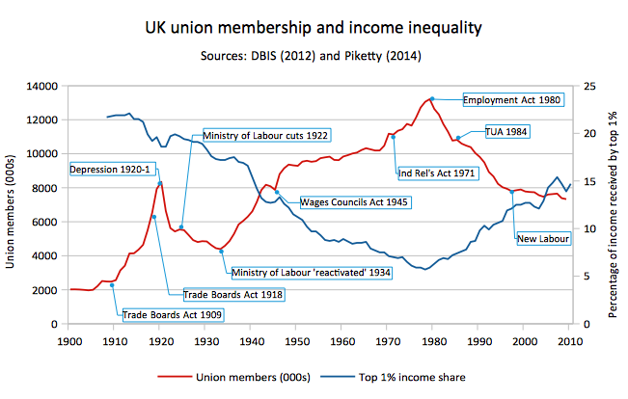
Notes:
Union membership in the United Kingdom has witnessed significant changes and fluctuations throughout its history, reflecting evolving economic, social, and political dynamics.
During the 19th and early 20th centuries, the UK labor movement experienced substantial growth, with unions forming to advocate for workers' rights, better working conditions, and fair wages.
Union membership reached its peak in the mid-20th century. By the late 1970s, approximately one in three workers in the UK were union members.
The 1980s brought a series of political and economic changes. The UK saw a notable decline in union membership due to factors like anti-union legislation, economic restructuring, and deindustrialisation.

Slide 33
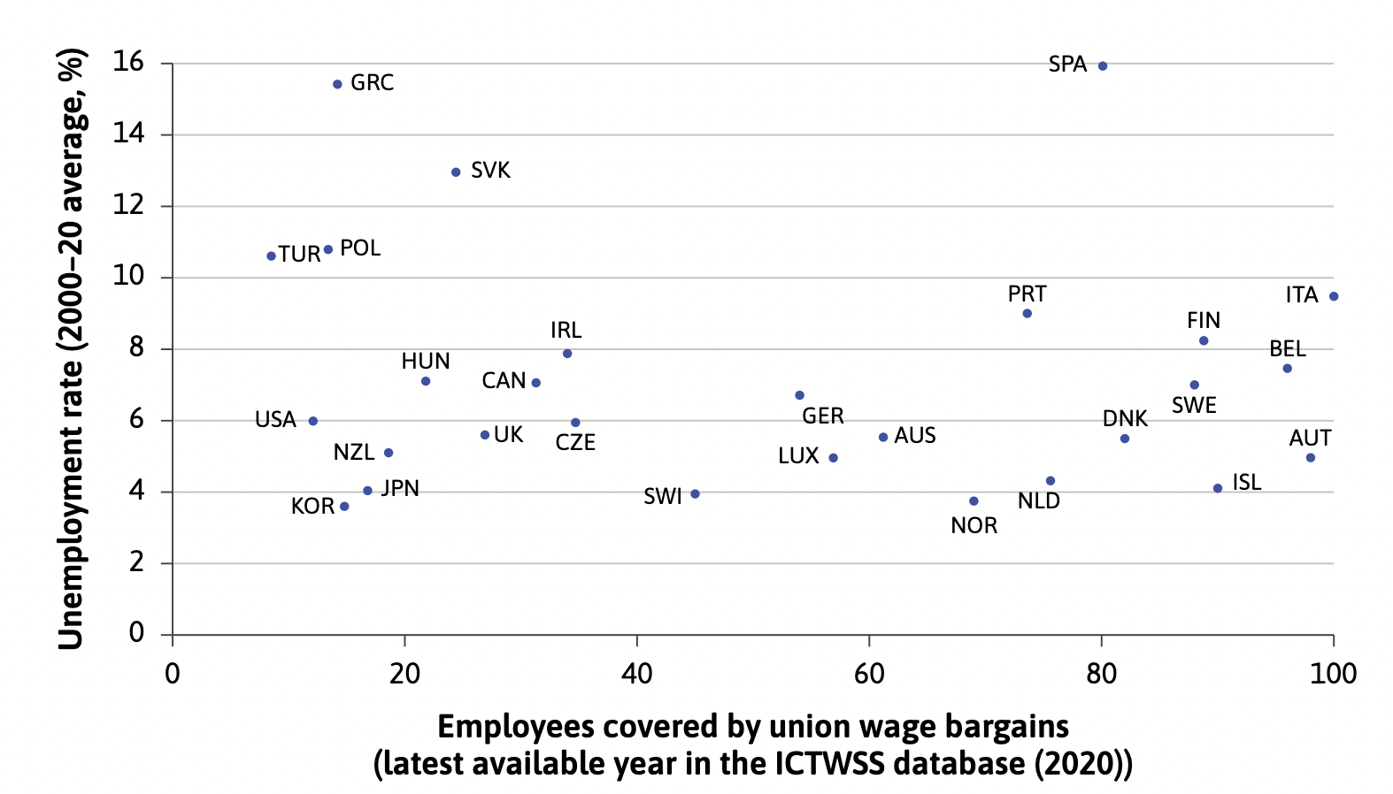
Graph of union participation and unemployment

Slide 34
Recent year of unions/strike in the News
Notes:
Test the students: What have you heard or know about the train strikes? Why are they striking?

Slide 35
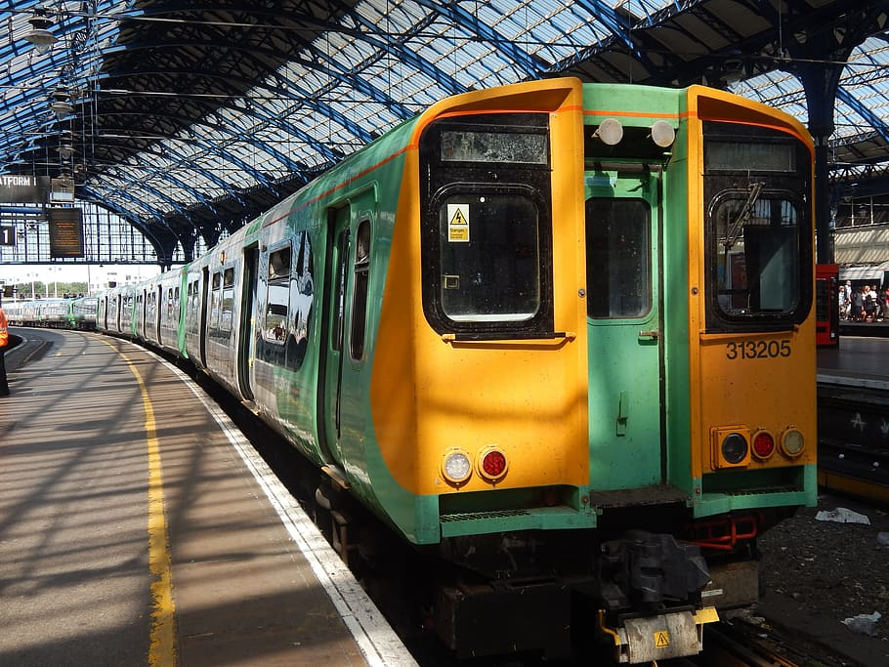
Key drivers of rail strike:
Pay and working conditions
Privatisation and franchise agreements
Safety concerns
Notes:
In recent years, the United Kingdom has witnessed a series of rail strikes that have garnered significant attention and sparked discussions on various fronts. These strikes, involving railway workers and unions, have had far-reaching implications for commuters, the rail industry, and the broader labor landscape in the UK.
Key Drivers of Rail Strikes:
Pay and Working Conditions: One of the primary catalysts for rail strikes has been disputes over pay and working conditions. Railway workers, including train drivers, conductors, and station staff, have demanded better pay, improved working hours, and enhanced job security.
Privatisation and Franchise Agreements: The privatisation of the UK's railways, initiated in the 1990s, has led to a complex network of franchise agreements. Workers' unions have argued that these agreements prioritise profit over employee welfare, leading to disputes over terms and conditions of employment.
Safety Concerns: Safety concerns, including staffing levels, training, and maintenance, have been central issues in rail strikes. Workers have called for increased investment in safety measures to protect both employees and passengers.
Impact on Commuters: Rail strikes have had a significant impact on commuters, leading to disruptions, delays, and inconvenience. This has fueled public debate on the legitimacy of strike actions and their effects on the broader population.
Resolution Efforts:
Efforts to resolve rail strikes have involved negotiations between worker unions, rail companies, and government bodies. Mediation and arbitration processes have been used to find common ground on contentious issues.
This serves as an example of ongoing wage negotiations/bargaining.

Slide 36
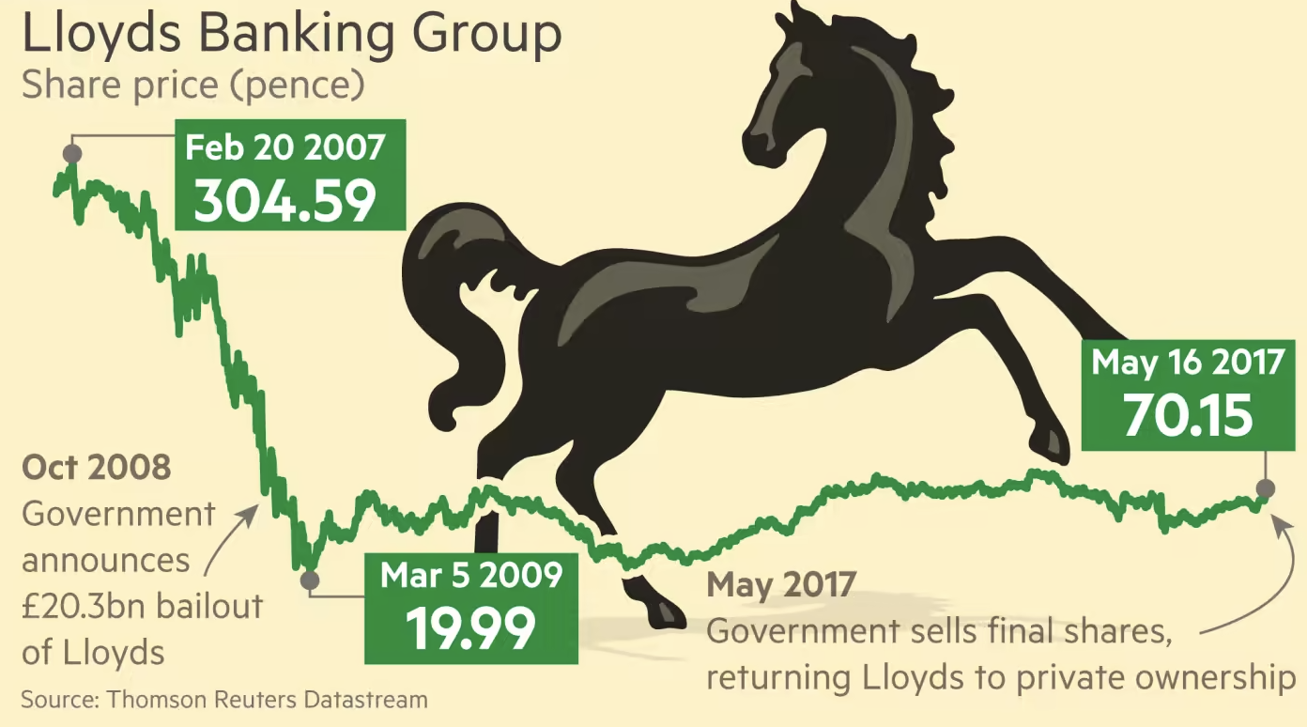
Formerly nationally owned companies
Notes:
Privatisation has been a notable and far-reaching policy shift since the late 20th century, especially in the UK. Historically, several types of companies and industries that were once nationally owned have undergone privatisation. These are some of the prominent examples:

Slide 37
Nationally owned companies today
Notes:
These privatisation initiatives have been driven by various motives, including increasing efficiency, reducing government involvement in the economy, and encouraging competition. While privatisation can lead to greater innovation and improved services, it has also sparked debates about equity, pricing, and access to essential services. Consequently, the impact of privatisation varies across industries and continues to be a subject of ongoing discussion and policy decisions.

Slide 38
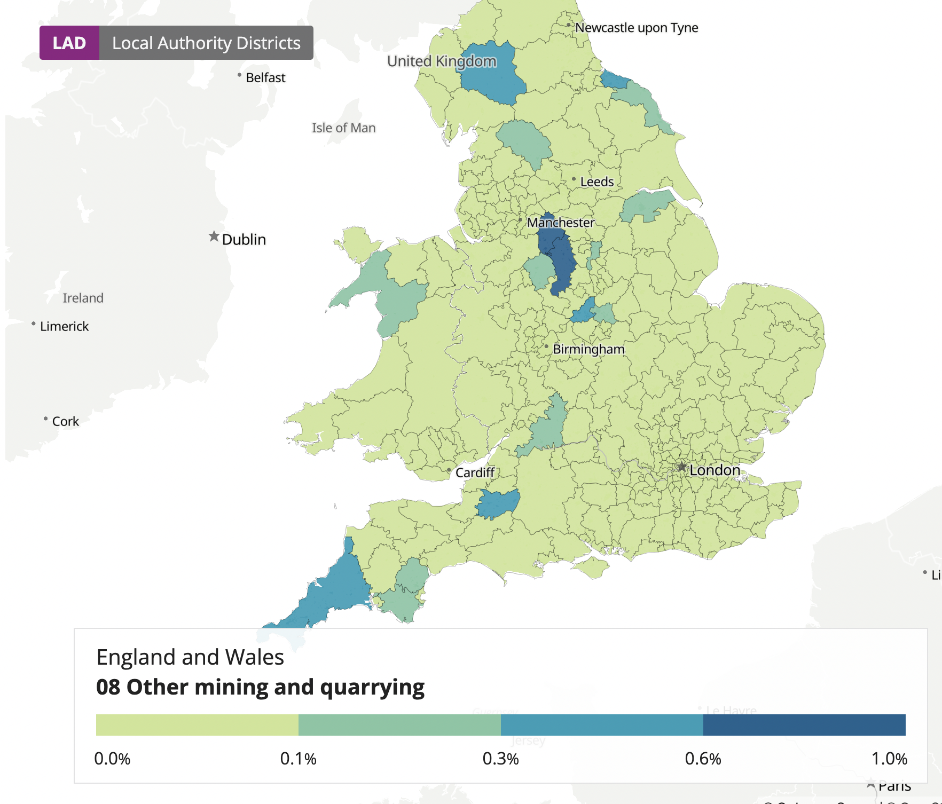
Share of workers employed in the mining/quarrying industry
Notes:
Insight into the geography of mining industry.
Source: https://www.ons.gov.uk/census/maps/choropleth/work/industry-current/industry-current-88a/08-other-mining-and-quarrying

Slide 39
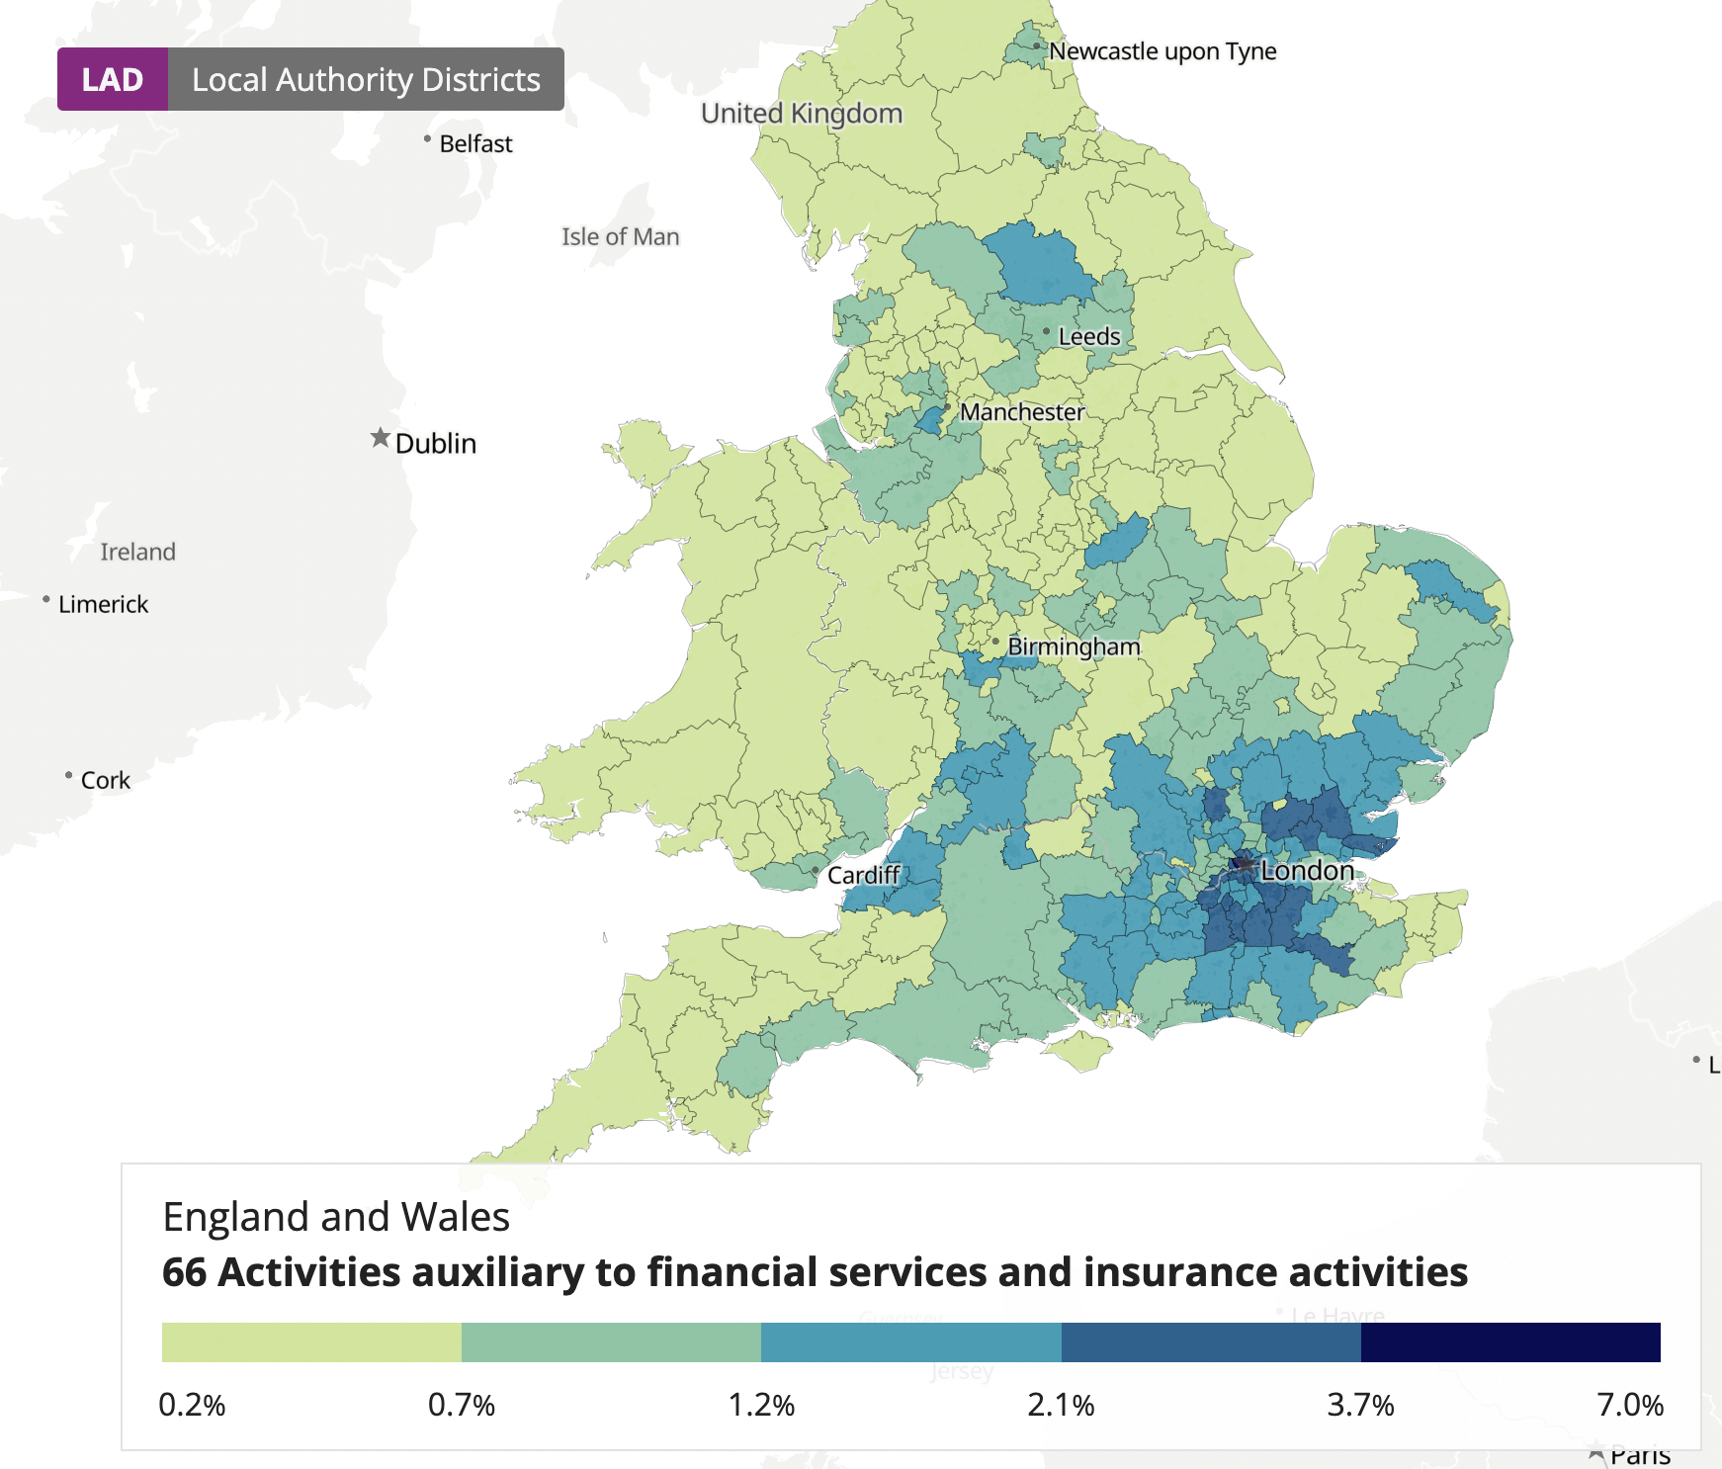
Share of workers employed with financial services and insurance activities
Notes:
Insight into the geography of the financial industry and its concentration.
Source: https://www.ons.gov.uk/census/maps/choropleth/work/industry-current/industry-current-88a

Slide 40
Part 3
Current challenges and strengths

Slide 41
Major Challenges Today
Productivity Puzzle
Low productivity growth
Bad performance relative to similar countries
Cost of Living Crisis
Low wages
Increasing food and energy prices

Slide 42
Notes:
There is an ongoing debate going on about UK’s productivity growth, which has been significantly slower than its peers.

Slide 43
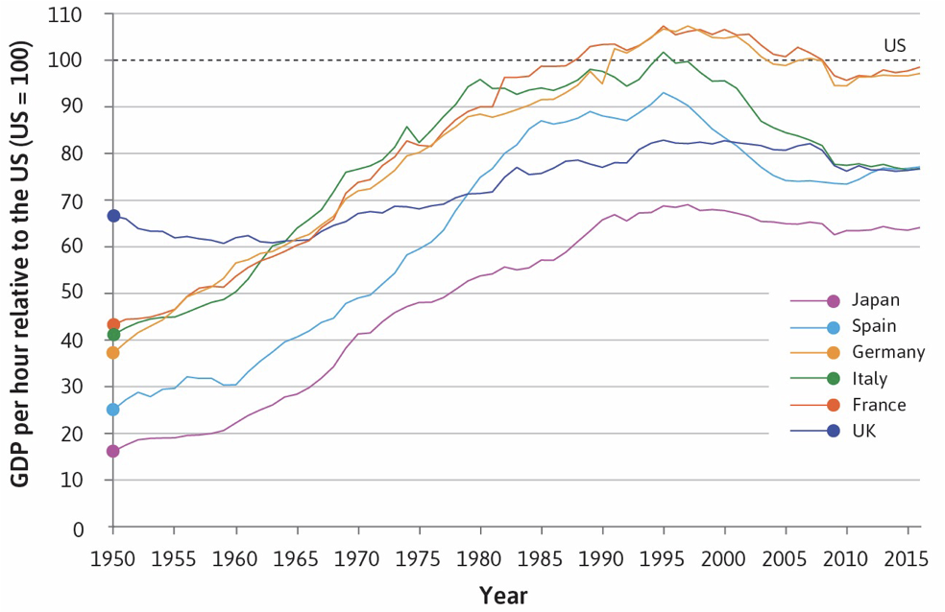
Notes:
How do we measure productivity? Usually it is measured as GDP per hours worked.
UK shows a much more stagnant growth when it comes to productivity.

Slide 44
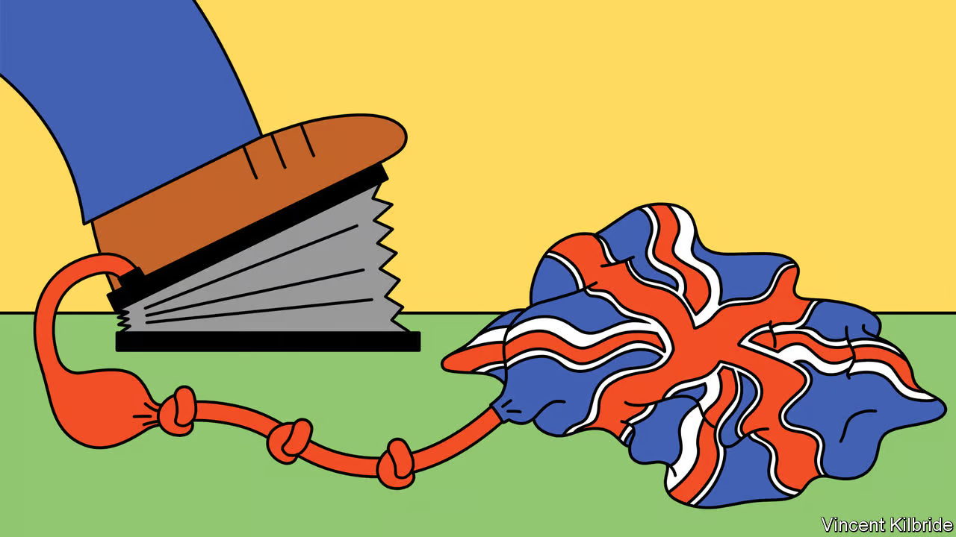
What are the possible reasons?
Notes:
Image source: https://www.economist.com/britain/2022/06/09/britains-productivity-problem-is-long-standing-and-getting-worse?utm_medium=cpc.adword.pd&utm_source=google&ppccampaignID=18156330227&ppcadID=&utm_campaign=a.22brand_pmax&utm_content=conversion.direct-response.anonymous&gclid=CjwKCAjw3ueiBhBmEiwA4BhspDP7dkJgWMoN0bpGybLtLgjDom4ynZgEhrrEMCGhiJOXkjRdsLTlAhoCSwkQAvD_BwE&gclsrc=aw.ds

Slide 45
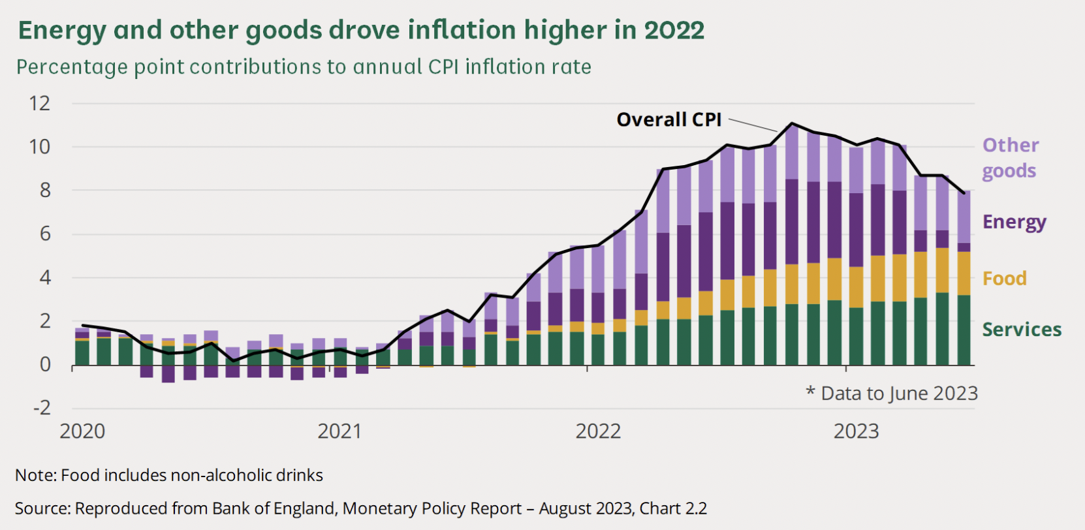
Cost of Living Crisis: Rise of Inflation in recent years
Notes:
Source: https://commonslibrary.parliament.uk/research-briefings/cbp-9428/

Slide 46
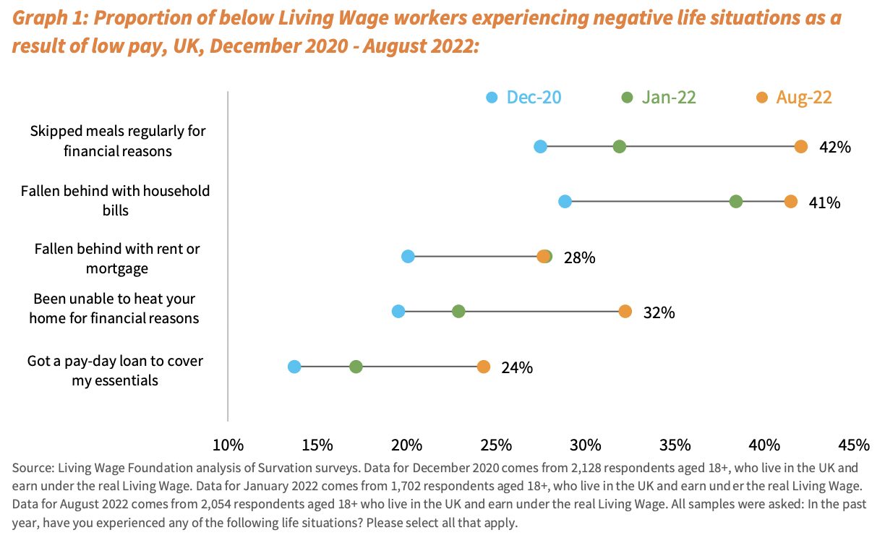
Cost of Living Crisis:

Slide 47
Strengths
Pharmaceutical industry
Tech industry
4th Global Innovation Index
A new report from KPMG suggests that the UK is the third most dynamic global centre of innovation
Notes:
https://www.wipo.int/global_innovation_index/en/2021/
https://info.kpmg.us/content/dam/info/en/techinnovation/pdf/2018/tech-hubs-forging-new-paths.pdf
https://www.businessinsider.com/sc/uk-science-tech-investment-boost-2022-2?international=true&r=US&IR=T

Slide 48
Classroom Activity

Slide 49
Research your own local economy
What are the main sectors ?
What is the concentration of the various classes?
To what degree do the sectors discussed benefit or harm your region?
Union activity?
Discuss finance for everywhere

Slide 50
Discuss strengths and weaknesses, draw on your own experiences
What do you see as the most important issues in the UK economy?
What sectors should be strengthened?

